Slide 1
Survey of Cache Compression

Slide 2
Outline
Background & Motivation
Block based cache compression
  FPC
  ZCA
  BDI
  SC²
  HyComp
Stream based cache compression
  MORC

Slide 3
Background
Cache is important…
Conflicts:
  Larger LLC → more area, more latency, more energy
  Limited LLC → off-chip access
Compression:
  Trade off latency for less off-chip access

Slide 4
Frequent Pattern Compression
An example:
1
1
21
13
2
3
5
8
…
8:
0000 0000 0000 0000
0000 0000 0000 1000
Pattern:
4-bits sign-extended
Notes:
Compression ratio : ~2

Slide 5
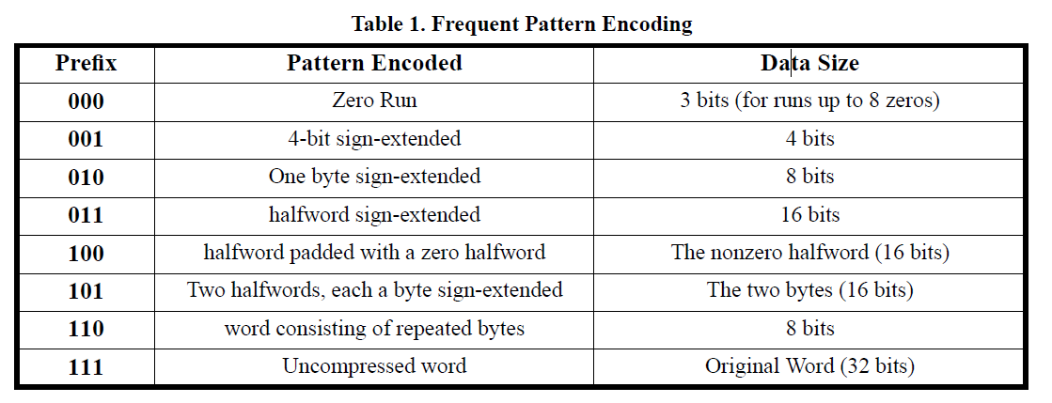
Frequent Pattern Compression
Patterns :
Notes:
Use 3bits prefix and 4~32 bits for content

Slide 6

Zero-content Augmentation
Common lines of code:
Several “blank” blocks
Notes:
Use few bits to represent a block

Slide 7
Base Delta Immediate
A simple example:
0x8048004
+, 0x0
+, 0x8
+, 0xc0
-, 0x4
0x8048004
0x8048008
0x80480c0
0x8048000

Slide 8
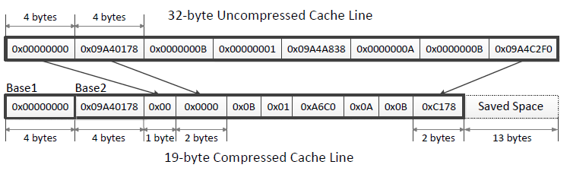
Base Delta Immediate
Multiple Bases:
Notes:
it is clear that not every cache line can be represented B+ delta with one base.
Having more than two bases does not provide additional
improvement in compression ratio
How to make use of the saved space ?

Slide 9
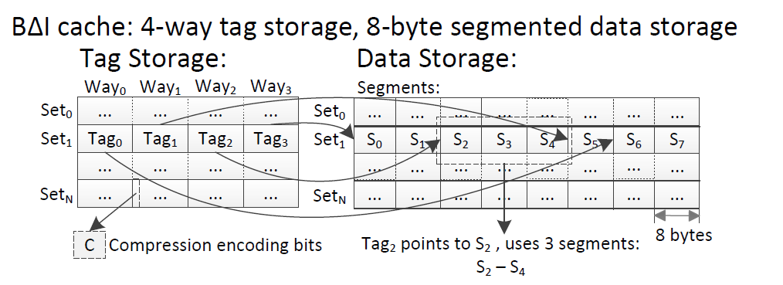
Base Delta Immediate
Organization:
Notes:
Number of tags is doubled, compression encoding bits are added to every tag, data storage is the same in size, but partitioned into segments.

Slide 10
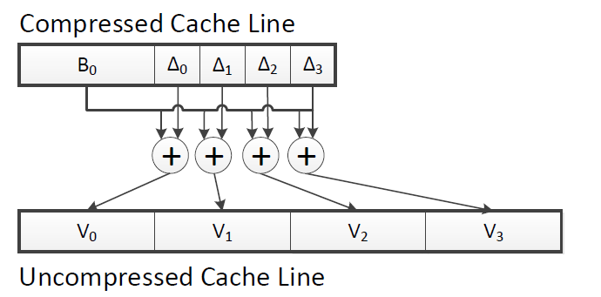
Base Delta Immediate
Decompression
Notes:
Compression ratio : ~2
Lower decompression latency

Slide 11
Statistical Cache Compression
Huffman encoding
“Heap” for sampling
The most mathematical method so far, in my opinion
Notes:
This circuit is too complex, not to develop the topic in class

Slide 12
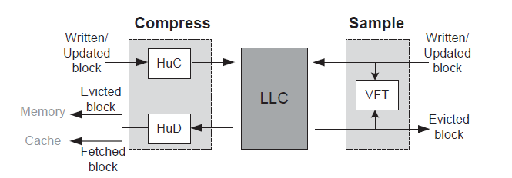
Statistical Cache Compression
Notes:
10 cycles for decompression
Compression ratio : 3~4

Slide 13
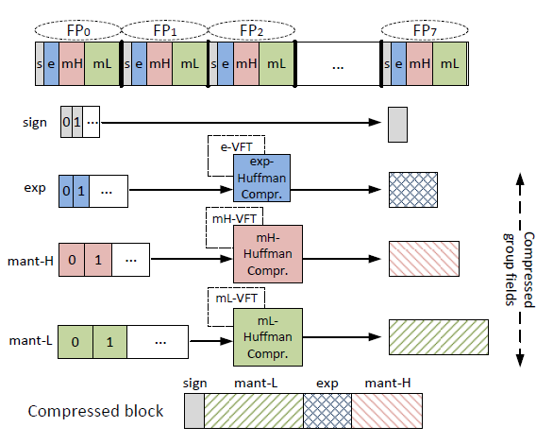
Hycomp
FP-H compression
Floating-point number specified compression method, based on SC²
Notes:
Compression is unusually not the critical path

Slide 14
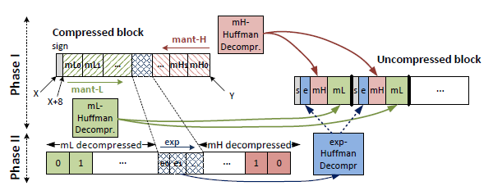
Hycomp
FP-H paralleled decompression
Notes:
However, decompression does.
Because Huffman encoding is not fix-sized, the offset of a certain segment cannot be recorded( otherwise, the compression ratio drops). a non-paralleled decompression processes mL, exp, and mH sequentially. However, a paralleled decompression processes mH and mH simultaneously in phase one, and then exp in phase 2

Slide 15
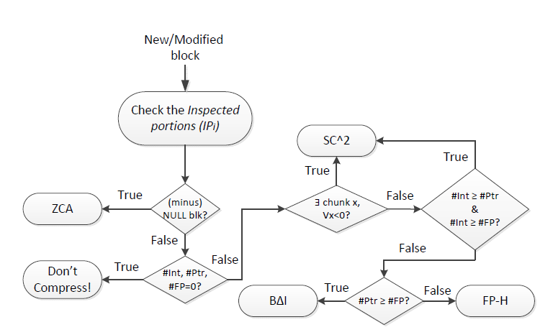
Hycomp
Hybrid compression
Notes:
Heuristics for Prediction of Data Types
Perform better on floating-pointing numbers
Compression ratio : ~4, 12cycles

Slide 16
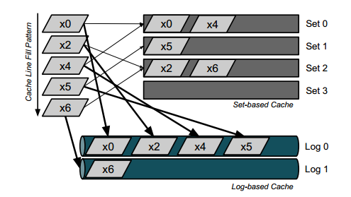
MORC
Log-based cache
Notes:
In fact, this picture is kind of misleading
MORC is loop-up-table based….

Slide 17
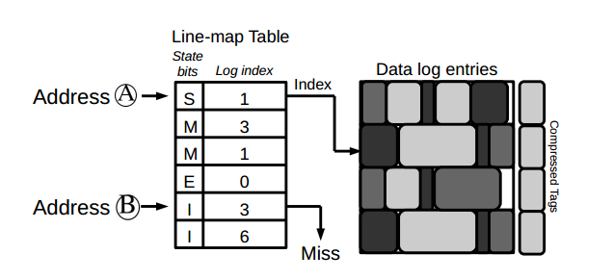
MORC
LMT

Slide 18
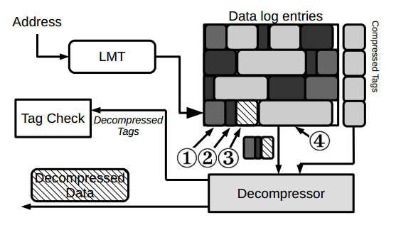
MORC
Notes:
LMT: valid bits for addrs
IF valid -> decompress tag & check tag
IF hit -> decompress data
OR check next tag
Sequentially ? Yes, because most tags will miss!

Slide 19
MORC
Throughput oriented
Manycore-Oriented-Compressed-Cache
  When cores accumulate, off-chip bandwidth limits performance
For throughput oriented works, reducing off-chip access is more important than reducing latency.
Less off-chip access saves energy
Notes:
~6

