Slide 1
Hardware Security:
Trusted Platform Module
Notes:
是指符合TPM（可信赖平台模块）标准的安全芯片

Slide 2
Hardware Security
Definition: implement security protection mechanisms in hardware
  E.g., design trusted hardware, as opposed to (in addition to) trusted software

Slide 3
Trusted or Trustworthy
A component of a system is trusted means that
  the security of the system depends on it
  failure of component can break the security policy
  determined by its role in the system
A component is trustworthy means that
  the component deserves to be trusted
  e.g., it is implemented correctly
  determined by intrinsic properties of the component
Notes:
系统的安全要依赖于它
组件出现问题的时候系统的安全策略就失效了
是否被相信是取决于它对整个系统起到的作用
是否有trustworthy取决于它本身的属性

Slide 4
Why Hardware Security
Software security: software protect software!
  Vulnerable to attacks
  Easy infiltration
  Fast spread
Hardware security: hardware protect software
  Attacks need physical access
  Software infiltration much more difficult
Notes:
Physical access is a term in computer security that refers to the ability of people to physically gain access to a computer system. According to Gregory White, "Given physical access to an office, the knowledgeable attacker will quickly be able to find the information needed to gain access to the organization's computer systems and network."

Slide 5
The Trusted Computing Group
non-profit industry consortium
develops hardware and software standards
funded by many member companies, including IBM, Intel, AMD, Microsoft, Sony, Sun, and HP among others.
Notes:
可信计算组织(TCG)是一个非营利性行业协会，像这些国际标准的硬件和软件的标准都是由它制定的。它是由许多成员公司,

Slide 6
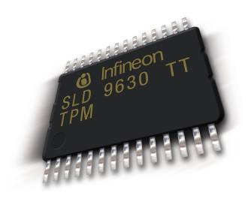
Trusted Platform Module (TPM)
technical specification was written by TCG
International standard for a secure cryptoprocessor
The purpose is to provide more security in hardware
secure hardware by integrating cryptographic keys into devices.
Notes:
Trusted Platform Module (TPM) is an international standard for a secure cryptoprocessor（密码处理器）, which is a dedicated microprocessor designed to secure hardware by integrating cryptographic keys into devices.
国际安全密码处理器的标准
它是通过将秘钥集成到设备的方式确保硬件安全

Slide 7
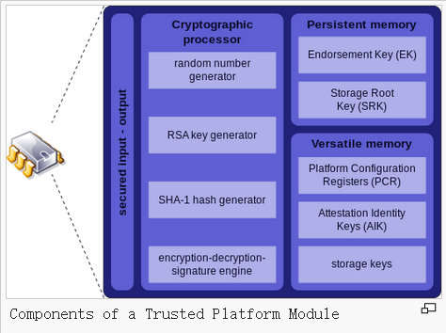

Slide 8
Goals
TPMs allow a system to:
  Gather and attest system state
  Store and generate cryptographic data
  Prove platform identity
Prevents unauthorized software
Helps prevent malware
Notes:
收集和证明系统的状态
证明平台的身份
阻止未经授权的软件
帮助阻止恶意软件

Slide 9
Limitations
Advanced features will require O/S support
Potential for abuse by Software vendors
  Co-processor or Cop-processor?
  “Trusted Computing requires you to surrender control of your machine to the vendors of your hardware and software, thereby making the computer less trustworthy from the user’s perspective” Ross Anderson
Notes:
存在许多鱼目混珠的软件供应商
就像是全球公认的安全权威之一的安德森说的：可信计算需要你向软硬件供应商交出你的机器控制权，这样一来从用户的角度电脑值得信赖的程度就会降低。

Slide 10
Real-World Applications
  Hard drive encryption
    BitLocker in Windows 8
  Trustworthy OS
    Google’s Chromebook use TPM to prevent firmware rollback
Notes:
BitLocker驱动器加密通过加密Windows操作系统卷上存储的所有数据可以更好地保护计算机中的数据。

Slide 11
BitLocker™ Drive Encryption Architecture
Static Root of Trust Measurement of boot components
Notes:
BitLocker驱动器加密通过加密Windows操作系统卷上存储的所有数据可以更好地保护计算机中的数据。

Slide 12
THANKS！

